Slide 1
Compiling P4 to Tofino
Michael Attig
November 4, 2019

Slide 2
Outline
Background
Main compilation problems
Key concepts and structures
Lessons
Summary, Discussion, and Q & A

Slide 3
P4 (in one slide)
Domain specific language for describing a network dataplane
Target independent
Packet “headers” as units of work
Describe parsers, controls (“match-action”), deparsers
Parsing
Match-action
Deparse
state parse_ipv6 {
pkt.extract(hdr.ipv6);
transition select(hdr.ipv6.next_hdr) {
PROTO_ICMP : parse_icmp;
PROTO_TCP : parse_tcp;
PROTO_UDP : parse_udp;
PROTO_IPV4 : parse_ipinip;
PROTO_IPV6 : parse_ipv6inip;
default : accept; }
}
table acl {
key = {
lkp.ip_src_addr : ternary;
lkp.ip_dst_addr : ternary;
lkp.ip_proto : ternary;
lkp.l4_src_port : ternary;
lkp.l4_dst_port : ternary; }
actions = {
acl_deny;
acl_permit;
acl_redirect; }
size = 8192;
}
apply {
pkt.emit(hdr.ethernet);
pkt.emit(hdr.vlan_tag);
pkt.emit(hdr.arp);
pkt.emit(hdr.ipv4);
pkt.emit(hdr.ipv6);
pkt.emit(hdr.udp);
pkt.emit(hdr.tcp);
}

Slide 4

Tofino
Processing
Pipeline 0
Traffic
Manager
Processing
Pipeline 1
SERDES / MACs
SERDES / MACs
Processing
Pipeline 2
Processing
Pipeline 3
SERDES / MACs
SERDES / MACs

Slide 5
Processing pipeline
Ingress
Egress
Parser 0
Parser 1
TPHV / CLOT
Parser 2
Parser 3
Parser 4
MAU
0
MAU
1
MAU
N
Egress
Ingress and Egress Deparsers
PHV
PHV
Parser 14
Parser 15
Shared by ingress
and egress processing
Parser 16
Parser 17
Packet Payload
Payload
Notes:
Describe packet flow
Header + payload
“Header” distributed across PHV/TPHV/CLOT
“Payload” sent to buffer (untouched)

Slide 6






Compilation outputs
API
Information
Tofino
configuration
Resource
map
Compiler
Characterization
Notes:
More akin to datapath synthesis.

Slide 7
Three optimization problems
PHV
Allocation
Tofino
Constraints
Parser
Bandwidth
Table Placement

Slide 8
PHV allocation
Determine register assignments at each point in the processing pipeline such that:
All live packet fields, metadata, temporary variables have an allocation
All hardware usage constraints satisfied
PHV₁
PHV₂
PHV₃
PHV_{N}
Parser
MAU
0
MAU
1
MAU
N
De-
Parser

Slide 9
A word on Tofino constraints...
Tofino PHV is fixed size
PHV is shared resource for ingress and egress processing
Static configuration, no spill memory
Register width | Tofino | Tofino2
32-bit | 64 | 48 / 16 / 16
16-bit | 96 | 72 / 24 / 24
8-bit | 64 | 48 / 16 / 16
 | 4096 bits (512 bytes) | 5120 bits (640 bytes)

Slide 10
PHV allocation tasks
Analysis & Initialization
Reference analysis → Where and how are fields used?
Live range analysis → Do fields persist?
Register sharing → Overlay / Packing
Clustering & Grouping → Field interactions
Program transformations
Variable initialization motion → Optimize location of initialization
Constraint mitigation → Utilize different implementation strategies
Allocation considerations
Hardware constraints
Flexible packing, e.g. bridged metadata, mirror headers, digests
Field slicing across registers
Register assignment → Final mapping from field slice to register

Slide 11
Example
// header
header ipv4_h {
...
bit<8> ttl;
bit<8> protocol;
bit<16> checksum;
bit<32> srcAddr;
bit<32> dstAddr; }
// parse
state parse_ipv4 {
pkt.extract(hdr.ipv4);
transition select(...) {...}
}
// mau
action route(bit<32> dst) {
hdr.ipv4.ttl = hdr.ipv4.ttl - 1;
hdr.ipv4.dstAddr = dst; }
// deparse
apply {
pkt.emit(hdr.ethernet);
pkt.emit(hdr.ipv4);
. . . }
ttl
no pack
alignment
proto
conditional
deparse
PHV
Allocation
live range
checksum
srcAddr
no pack
dstAddr
[31:16]
alignment
live
range
dstAddr
[15:0]

Slide 12
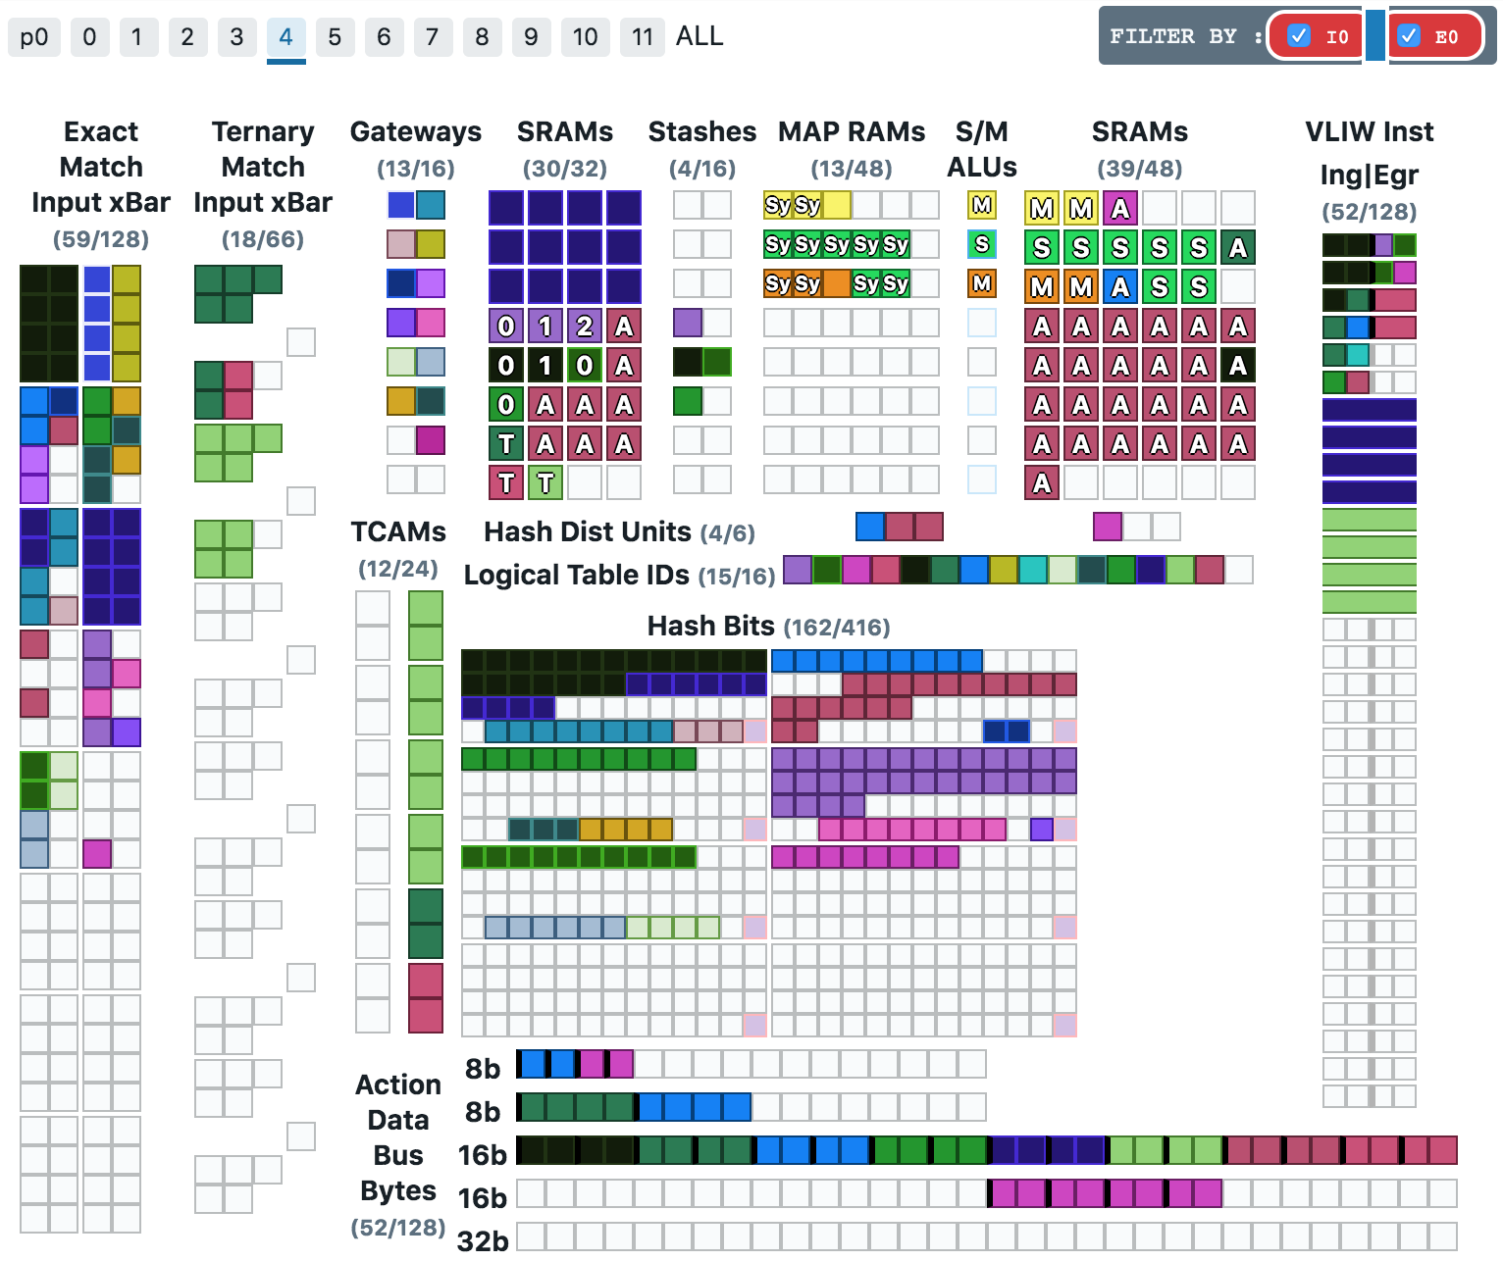
Table placement
Allocate MAU resources such that:
All match tables and attached tables provide minimum entries required
All program dependencies satisfied
All hardware resource constraints satisfied
table acl {
key = {
lkp.ip_src_addr : ternary;
lkp.ip_dst_addr : ternary;
lkp.ip_proto : ternary;
lkp.l4_src_port : ternary;
lkp.l4_dst_port : ternary; }
actions = {
acl_deny;
acl_permit;
acl_redirect; }
size = 8192;
}

Slide 13
Tofino MAU
PHV
ALUs
PHV
PHV
Exact
Match
Input
Crossbar
SRAM
Array
(left)
Map
RAM
Array
SRAM
Array
(right)
Action Data Bus
Hash
6
2
3
3
1
Gateways
5
5
5
6
VLIW
6
4
Next Table
Next Table
Match Central
Ternary
Match
Input
Crossbar
TCAM
Array
4
1
3

Slide 14
Table placement tasks
Analysis & Initialization
Dependency analysis → Where and how are fields used?
Enumerate table layout possibilities → Memory efficiency achievable?
Program transformations
Tofino “lowering” → Cast in Tofino native form
Table motion → Reorder control flow
Table / Action splitting → Partition to efficiently utilize resources
Allocation considerations
Hardware constraints
Bin packing
Table selection → How decide placement order?
Resource selection & management
Power & latency minimization

Slide 15
P4 complications
action route(bit<16> x) {
hdr.ipv4.id = hdr.ipv4.id + x;
}
1 MAU
action route(bit<16> x) {
hdr.ipv4.id = hdr.ipv4.id + meta.m + x;
}
2 MAUs

Slide 16
PHV implications
Register alignment
TCAM usage
vs

Slide 17
PHV implications
Register packing
MAU placement
MAU 0
T1
T1
T2
T2
vs
MAU 0
MAU 1
T1
T1
T2
T2

Slide 18
Parser bandwidth
Assign parser TCAM states such that:
All packet fields written to PHV registers (or CLOTs)
Minimum number of states used per packet path
Conversely, maximize amount of packet data consumed per state
All hardware resource constraints satisfied
Parser TCAM
state parse_ipv6 {
pkt.extract(hdr.ipv6);
transition select(hdr.ipv6.next_hdr) {
PROTO_ICMP : parse_icmp;
PROTO_TCP : parse_tcp;
PROTO_UDP : parse_udp;
PROTO_IPV4 : parse_ipinip;
PROTO_IPV6 : parse_ipv6inip;
default : accept; }
}
v6_icmp
v6_tcp
v6_udp
v6_inner_v4
v6_inner_v6

Slide 19
Parser bandwidth tasks
Analysis & Initialization
Graph analysis → What are feasible packet structures?
Live range analysis → Where and how are fields used?
Program transformations
Tofino “lowering” → Cast in Tofino native form
Speculative merging
Allocation considerations
Hardware constraints
State splitting and/or merging
Resource allocation & management

Slide 20
PHV implications
ver
diff
srcAddr[31:0]
parse_ipv4
len
dstAddr[31:0]
id
and
vs
offset
parse_ipv4
srcAddr
[31:16]
srcAddr [15:0]
ttl
proto
parse_ipv4_spill
dstAddr [31:16]
dstAddr [15:0]
checksum

Slide 21
Key concepts
Transaction-based allocation
Device model
Visibility!
Knobs

Slide 22
Transactions
Bundle allocation choices in transaction units
Enumerate Choices
Final Selection
Select
Allocate
scores
Simplifies
Parallel search
Search-space pruning
Back-tracking
Heuristic scoring
Visibility
Requires
Memory for partial solution state
Try / Commit infrastructure
Metrics

Slide 23
Device model
Abstract hardware target as much as possible
Capacity, parameters, bit widths, etc.
Device constraints abstraction
Class specialization
Simplifies
Addition of new targets
Future target design space exploration
Prevents if (target == Tofino2)
Bring-up testing
Logging utilization
Requires
Ability to parameterize allocation algorithms
Memory for representation
Understanding hardware during class definition

Slide 24
Visibility
Optimizing P4 for Tofino requires understanding
Device constraints
Program constraints
Compiler’s point of reference
How compiler navigates search space
Common questions:
Why can’t field J reuse registers used by field K?
Why was table X placed in MAU N instead of N-1?
What is parser performance for packets of form W / X / Y / Z ?

Slide 25
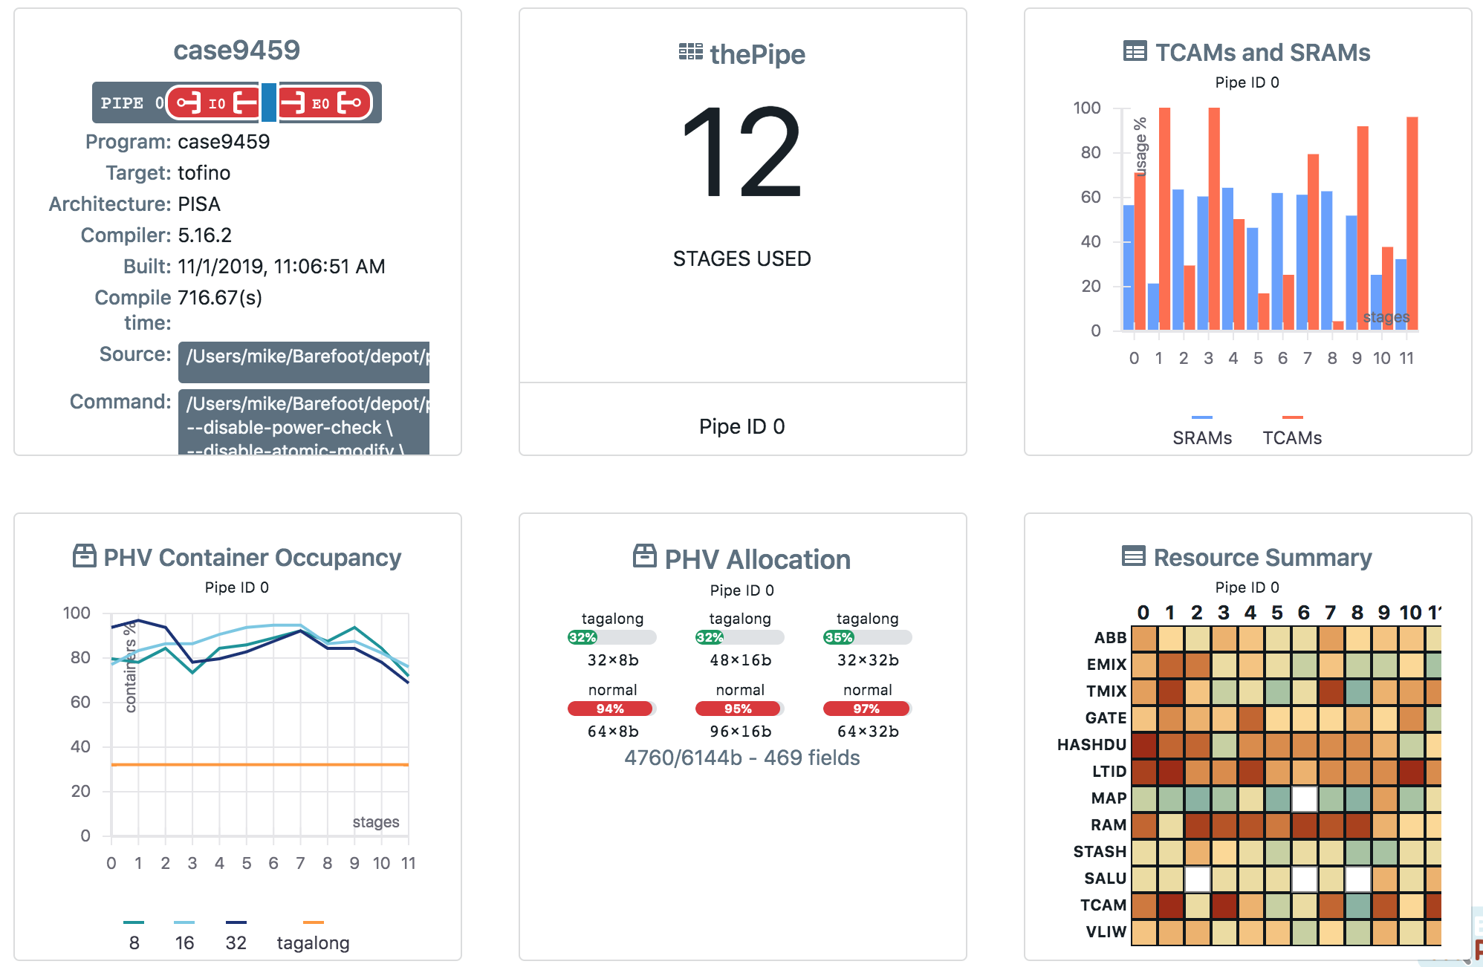
Organize information through tools
Graphs
Resource
Utilization
switch
Decision Logging
Allocation choices
P4 Insight
Program Constraints
Transformations

Slide 26
Fine-grain control
Power users want more influence on compiler decisions
Allocation hooks through annotations or pragmas
Tend to be sticky!
Difficult to understand implication combinatorics
But… can overcome a limitation

Slide 27
What did we get wrong
Developer-centric error messages
Transform from developer mindset to customer mindset
Unit testing
It’s hard -- everything’s an integration test!
Documentation priority
Impedes ramp-up
IR out of sync with hardware capabilities
Better now - comes with understanding and continuous refactoring

Slide 28
Continuous improvement
Optimize, optimize, optimize!
Actionable error messages
Compilable P4 programs
Document once in source
Structured logging
t

Slide 29
Summary
Three main optimization problems
PHV allocation
Table placement
Parser bandwidth
Key compiler concepts
Infrastructure flexibility does not sacrifice performance
Visibility drives scalability

Slide 30
Thank you!
Questions?

